Slide 1
Car Sales Analysis - Power BI

Slide 2
Introduction
• This project analyzes car sales performance using Power BI.
• Dashboard provides insights into sales trends, top-selling models, and regional performance.
• Data-driven visuals support strategic decisions.

Slide 3
Problem Statement
• Lack of visibility into car sales trends.
• No clear view of best and worst-performing models.
• Reports are manually created and time-consuming.
• Need for an automated Power BI dashboard.

Slide 4
Key Metrics (KPIs)
• Total Sales
• Total Units Sold
• Best Selling Car Model
• Sales by Region
• Monthly & Yearly Growth
• Dealer Performance

Slide 5
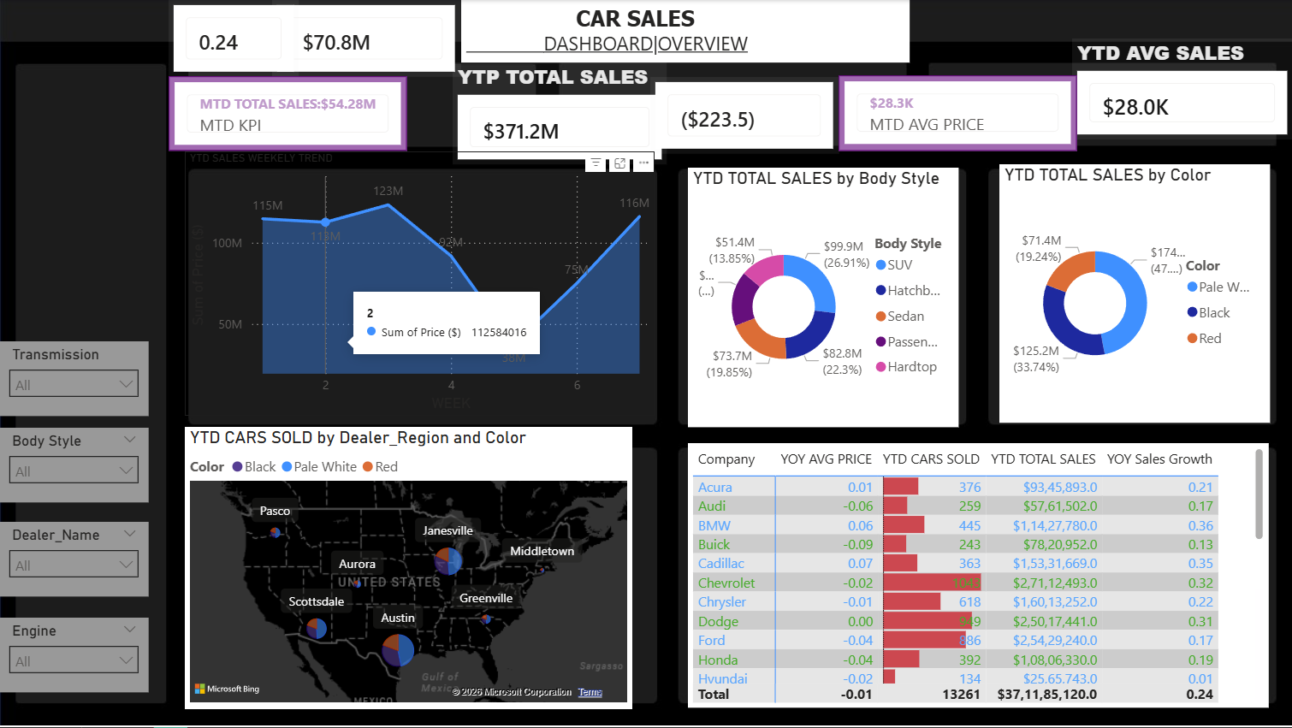
Dashboard View 1
• Overview dashboard showing total sales, trends, and summary KPIs.

Slide 6
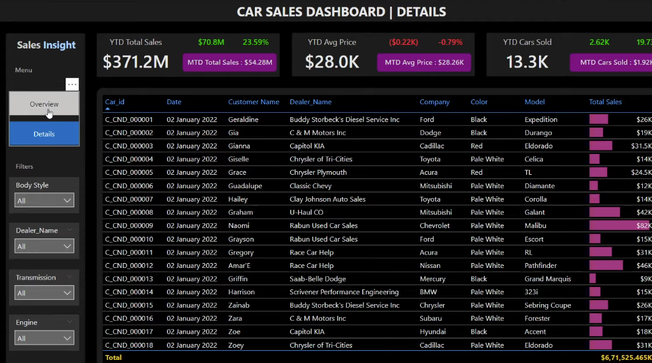
Dashboard View 2
• Detailed dashboard with model-wise, dealer-wise, and region-wise performance analysis.

